Slide 1
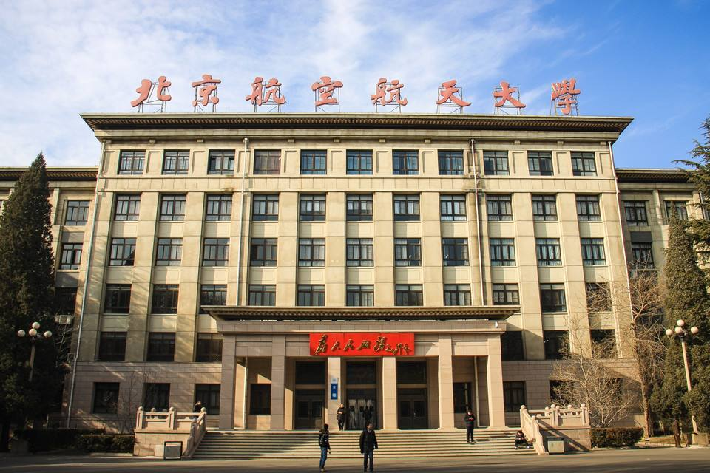



BEIHANG UNIVERSITY
FEDformer_MindSpore
——用FEDformer求解时间序列预测问题
2025年06月16日
小组成员：谢浩志_ZY2406222 黄星阳_ZY2406437

Slide 2




BEIHANG UNIVERSITY
目 录
01
背景与问题定义
CONTENTS
02
研究现状与主要挑战
03
论文方法介绍
04
复现挑战与解决方法
05
实验结果与分析

Slide 3
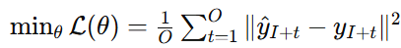
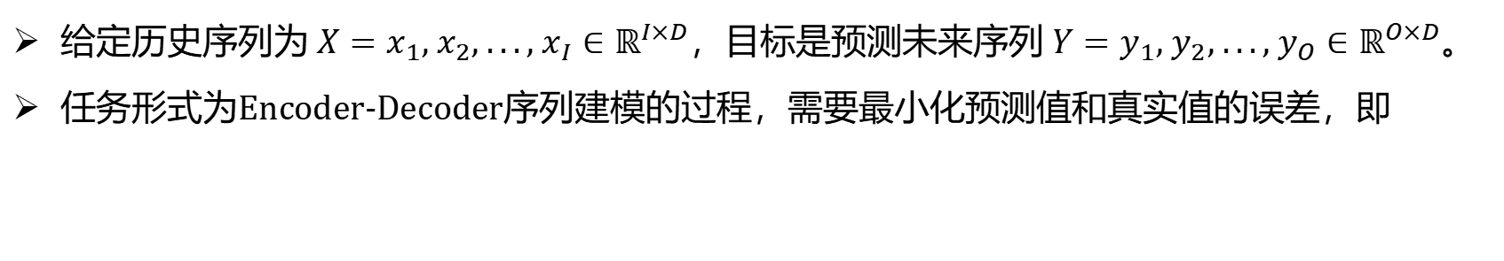
背景与问题定义
BEIHANG UNIVERSITY
长时间序列预测的背景
数据难题：长时间序列通常具有跨度大、特征维度高、噪声干扰强等特点，增加了建模难度与预测不确定性。
模型难题：传统模型如RNN在长序列建模中易出现梯度消失或爆炸，难以捕捉长期依赖结构，预测精度受限。
问题形式化定义
给定历史序列为$X=x_{1}, x_{2}, ..., x_{I}∈ℝ^{I×D}$，目标是预测未来序列$Y=y_{1}, y_{2}, ..., y_{O}∈ℝ^{O×D}$。
任务形式为Encoder-Decoder序列建模的过程，需要最小化预测值和真实值的误差，即
时间序列预测面临数据复杂与模型建模能力双重挑战

Slide 4
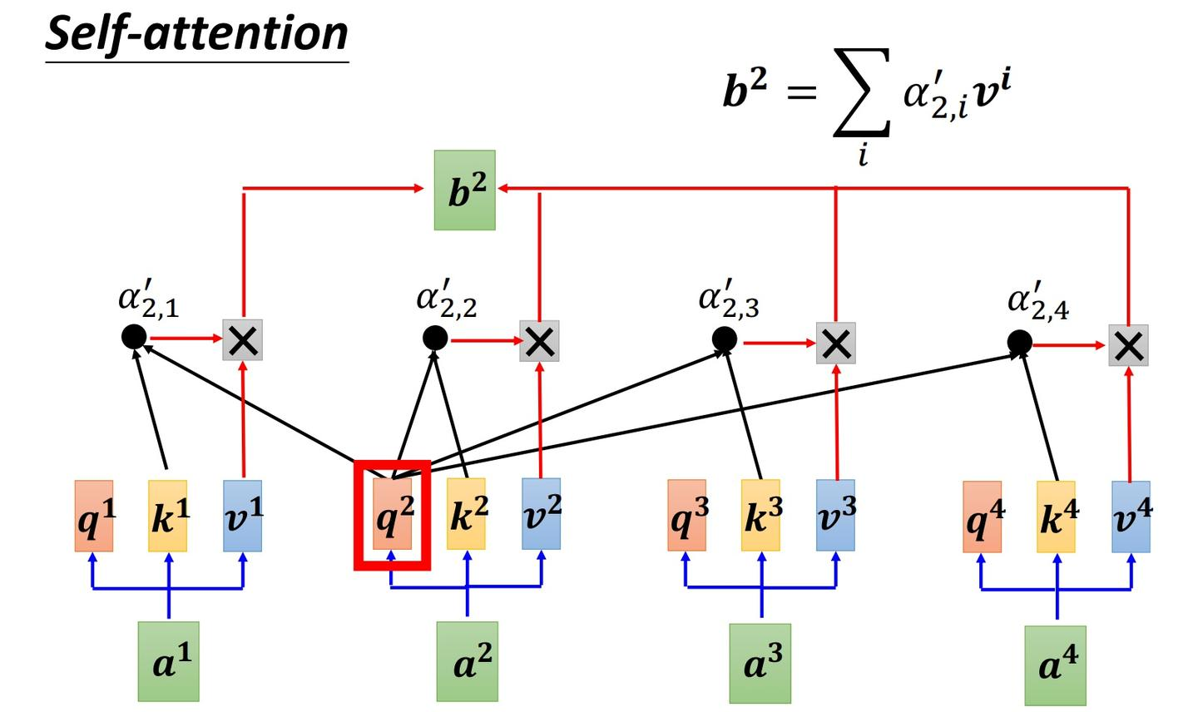
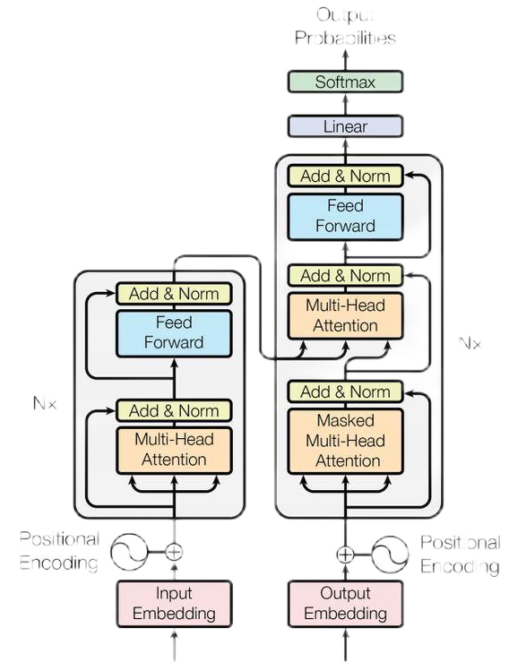
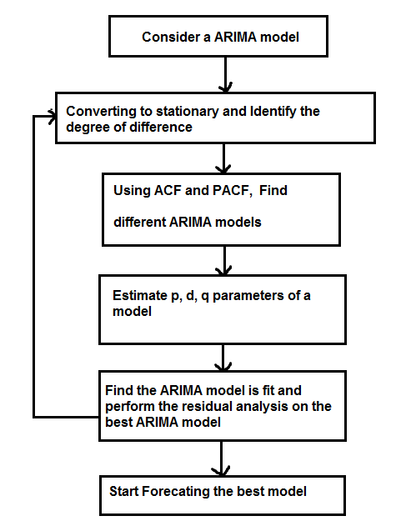
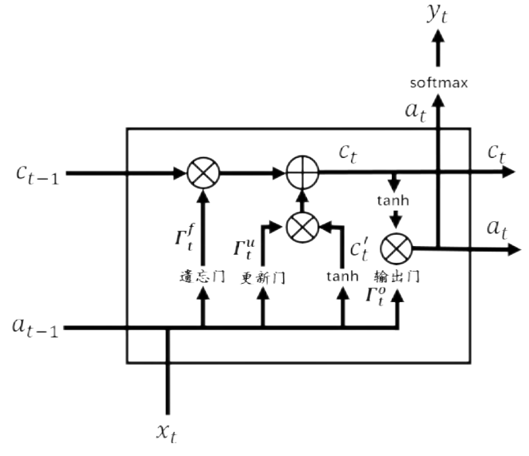
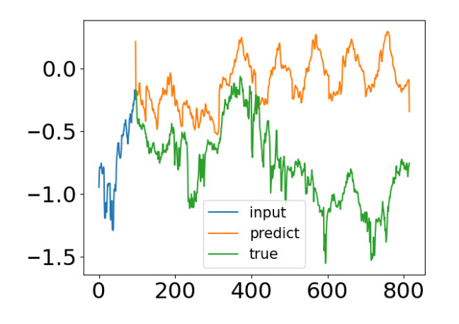
研究现状与主要挑战
BEIHANG UNIVERSITY
时间序列相关研究
挑战1：自注意力计算开销大
传统模型（ARIMA）：无法建模非线性关系
RNN-based模型：难以捕捉长期依赖
Transformer模型：使用较为广泛
挑战2：难以捕捉季节/趋势特征
研究核心难点：降低计算成本、捕捉时序数据的全局结构特征

Slide 5
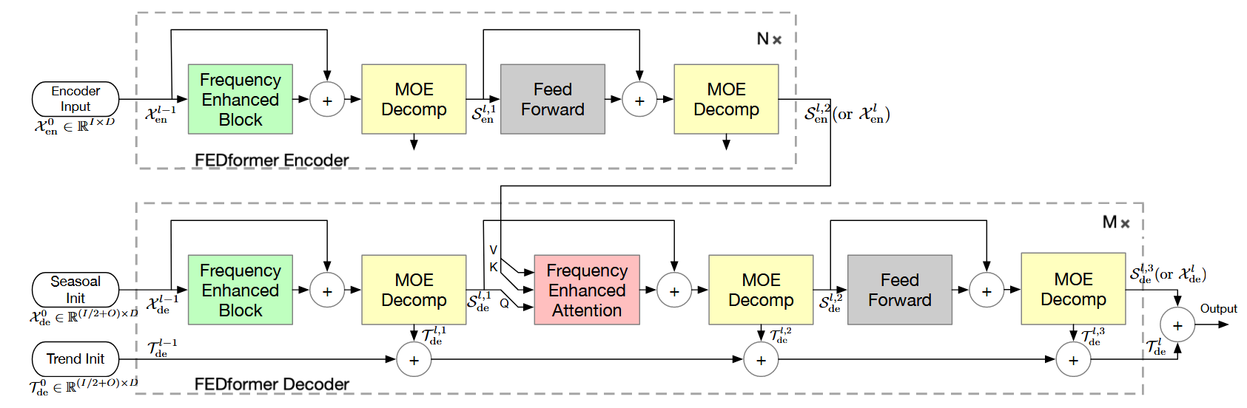
论文方法介绍
BEIHANG UNIVERSITY
FEDformer模型结构与核心机制
核心结构1：引入序列分解机制，将预测任务分解为趋势建模与季节建模【把握全局特征】；
核心结构2：使用 Fourier / Wavelet 变换在频域执行注意力计算，减少复杂度至$O(L)$【加速】。
FEDformer方案：融合分解建模与频域注意力，实现高效长期预测

Slide 6
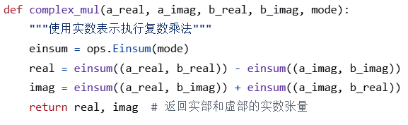
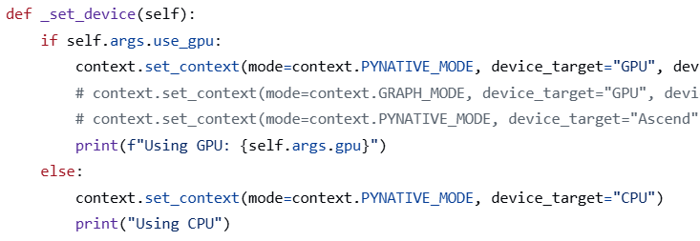
复现挑战与解决方法
BEIHANG UNIVERSITY
迁移适配主要问题
问题一：昇腾平台不支持 FFTWithSize，频域模块无法运行
迁移至 NVIDIA Tesla P100 显卡环境执行；
问题二：Grad 算子不支持复数
将复数计算模块封装为实部/虚部分离表示，规避反向传播问题；
问题三：图模式支持有限
整体采用 PYNATIVE 模式运行，确保训练稳定性与模块兼容性。
复数计算封装
运行模式设定
模型迁移：规避框架限制

Slide 7
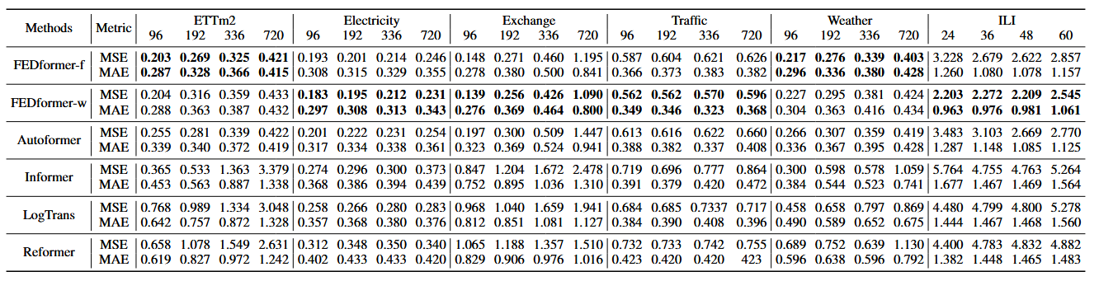
实验结果与分析
BEIHANG UNIVERSITY
实验设置与结果分析
原始结果表
实验设置：
对比模型：Transformer、Informer、Autoformer；
数据集：Electricity, Exchange, Traffic, Weather；
设置：预测步长为96，多变量预测任务；
结果分析：
FEDformer在Exchange与Weather数据集表现领先，针对季节性趋势性数据预测效果良好；
与原文结果存在差距。原因包括平台差异、复数运算近似、动态图运行限制等；
总体趋势一致，验证了FEDformer频域建模在长序列预测中的有效性与鲁棒性。
复现结果表
方法 | 指标\数据集 | Electricity | Exchange | Traffic | Weather
Transformer | MAE | 0.830 | 1.418 | 0.911 | 1.580
 | RMSE | 1.014 | 1.784 | 1.315 | 2.066
 | MAPE | 3.238 | 12.247 | 5.847 | 25.460
Informer | MAE | 0.938 | 1.589 | 0.963 | 1.743
 | RMSE | 1.133 | 1.954 | 1.353 | 2.233
 | MAPE | 5.320 | 9.693 | 7.462 | 31.488
Autoformer | MAE | 1.698 | 0.278 | 1.941 | 2.379
 | RMSE | 2.016 | 0.385 | 2.265 | 3.797
 | MAPE | 13.925 | 1.691 | 25.638 | 87.032
FEDformer | MAE | 1.326 | 0.278 | 1.795 | 0.319
 | RMSE | 1.562 | 0.386 | 2.101 | 0.501
 | MAPE | 10.921 | 1.699 | 24.045 | 18.864
实验验证结论：特定数据性能领先，与原框架实现有一定差异

Slide 8
参考文献
BEIHANG UNIVERSITY
[1]Box G E P, Jenkins G M. Some recent advances in forecasting and control[J]. Journal of the Royal Statistical Society. Series C (Applied Statistics), 1968, 17(2): 91-109.
[2]Box G E P, Pierce D A. Distribution of residual autocorrelations in autoregressive-integrated moving average time series models[J]. Journal of the American statistical Association, 1970, 65(332): 1509-1526.
[3]Hochreiter S, Schmidhuber J. Long short-term memory[J]. Neural computation, 1997, 9(8): 1735-1780.
[4]Chung J, Gulcehre C, Cho K H, et al. Empirical evaluation of gated recurrent neural networks on sequence modeling[J]. arXiv preprint arXiv:1412.3555, 2014.
[5]Salinas D, Flunkert V, Gasthaus J, et al. DeepAR: Probabilistic forecasting with autoregressive recurrent networks[J]. International journal of forecasting, 2020, 36(3): 1181-1191.
[6]Qin Y, Song D, Chen H, et al. A dual-stage attention-based recurrent neural network for time series prediction[J]. arXiv preprint arXiv:1704.02971, 2017.
[7]Sen R, Yu H F, Dhillon I S. Think globally, act locally: A deep neural network approach to high-dimensional time series forecasting[J]. Advances in neural information processing systems, 2019, 32.
[8]Vaswani A, Shazeer N, Parmar N, et al. Attention is all you need[J]. Advances in neural information processing systems, 2017, 30.
[9]Beltagy I, Peters M E, Cohan A. Longformer: The long-document transformer[J]. arXiv preprint arXiv:2004.05150, 2020.
[10]Li S, Jin X, Xuan Y, et al. Enhancing the locality and breaking the memory bottleneck of transformer on time series forecasting[J]. Advances in neural information processing systems, 2019, 32.
[11]Zhu Z, Soricut R. H-transformer-1d: Fast one-dimensional hierarchical attention for sequences[J]. arXiv preprint arXiv:2107.11906, 2021.
[12]Zhou H, Zhang S, Peng J, et al. Informer: Beyond efficient transformer for long sequence time-series forecasting[C]//Proceedings of the AAAI conference on artificial intelligence. 2021, 35(12): 11106-11115.
[13]Wu H, Xu J, Wang J, et al. Autoformer: Decomposition transformers with auto-correlation for long-term series forecasting[J]. Advances in neural information processing systems, 2021, 34: 22419-22430.
[14]Wang S, Li B Z, Khabsa M, et al. Linformer: Self-attention with linear complexity[J]. arXiv preprint arXiv:2006.04768, 2020.
[15]Ma X, Kong X, Wang S, et al. Luna: Linear unified nested attention[J]. Advances in Neural Information Processing Systems, 2021, 34: 2441-2453.
[16]Xiong Y, Zeng Z, Chakraborty R, et al. Nyströmformer: A nyström-based algorithm for approximating self-attention[C]//Proceedings of the AAAI conference on artificial intelligence. 2021, 35(16): 14138-14148.
[17]Choromanski K, Likhosherstov V, Dohan D, et al. Rethinking attention with performers[J]. arXiv preprint arXiv:2009.14794, 2020.
[18]Mathieu M, Henaff M, LeCun Y. Fast training of convolutional networks through ffts[J]. arXiv preprint arXiv:1312.5851, 2013.
[19]Wen Q, He K, Sun L, et al. RobustPeriod: Robust time-frequency mining for multiple periodicity detection[C]//Proceedings of the 2021 international conference on management of data. 2021: 2328-2337.
[20]Li Z, Kovachki N, Azizzadenesheli K, et al. Fourier neural operator for parametric partial differential equations[J]. arXiv preprint arXiv:2010.08895, 2020.
[21]Gupta G, Xiao X, Bogdan P. Multiwavelet-based operator learning for differential equations[J]. Advances in neural information processing systems, 2021, 34: 24048-24062.
[22]Rahimi A, Recht B. Random features for large-scale kernel machines[J]. Advances in neural information processing systems, 2007, 20.
[23]Rawat A S, Chen J, Yu F X X, et al. Sampled softmax with random fourier features[J]. Advances in Neural Information Processing Systems, 2019, 32.
[24]Lee-Thorp J, Ainslie J, Eckstein I, et al. Fnet: Mixing tokens with fourier transforms[J]. arXiv preprint arXiv:2105.03824, 2021.

Slide 9

BEIHANG UNIVERSITY
Thanks!
2025年06月16日
小组成员：谢浩志_ZY2406222 黄星阳_ZY2406437

